Slide 1
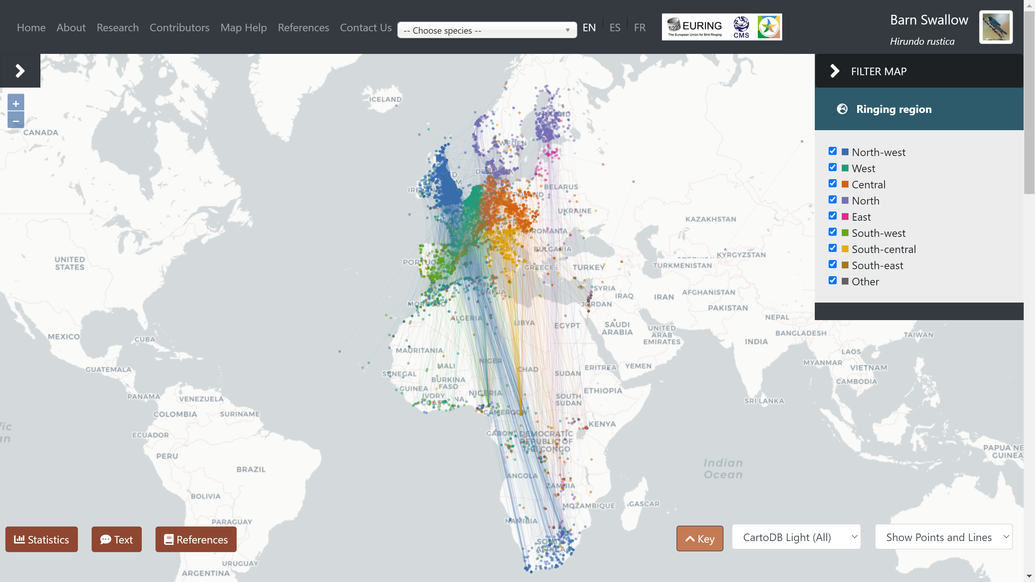
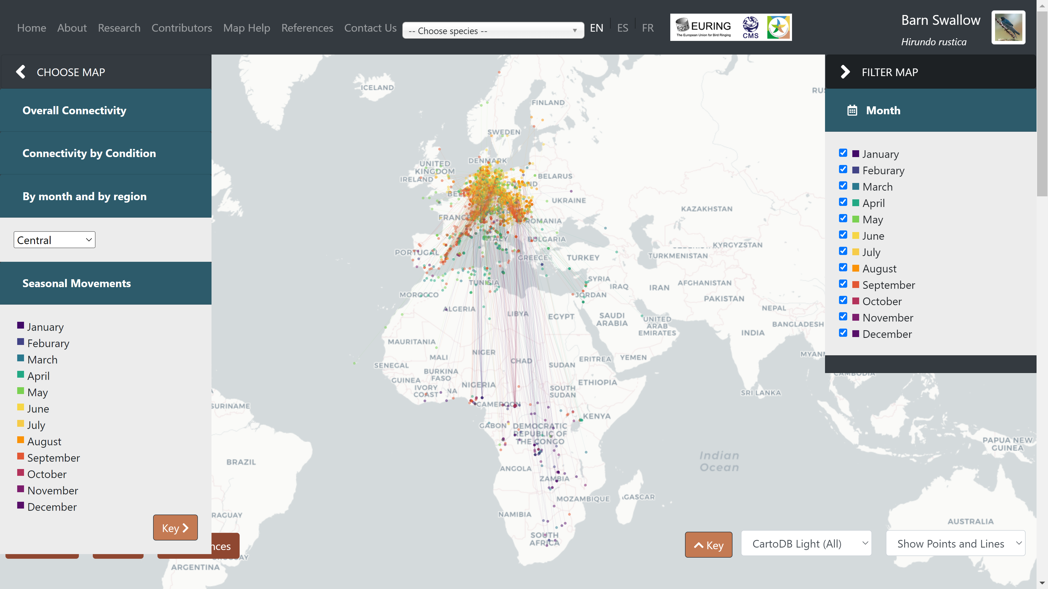
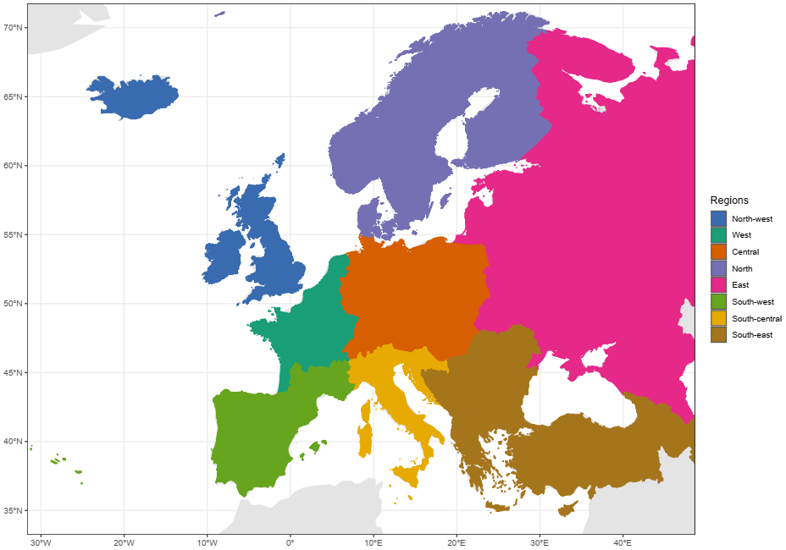
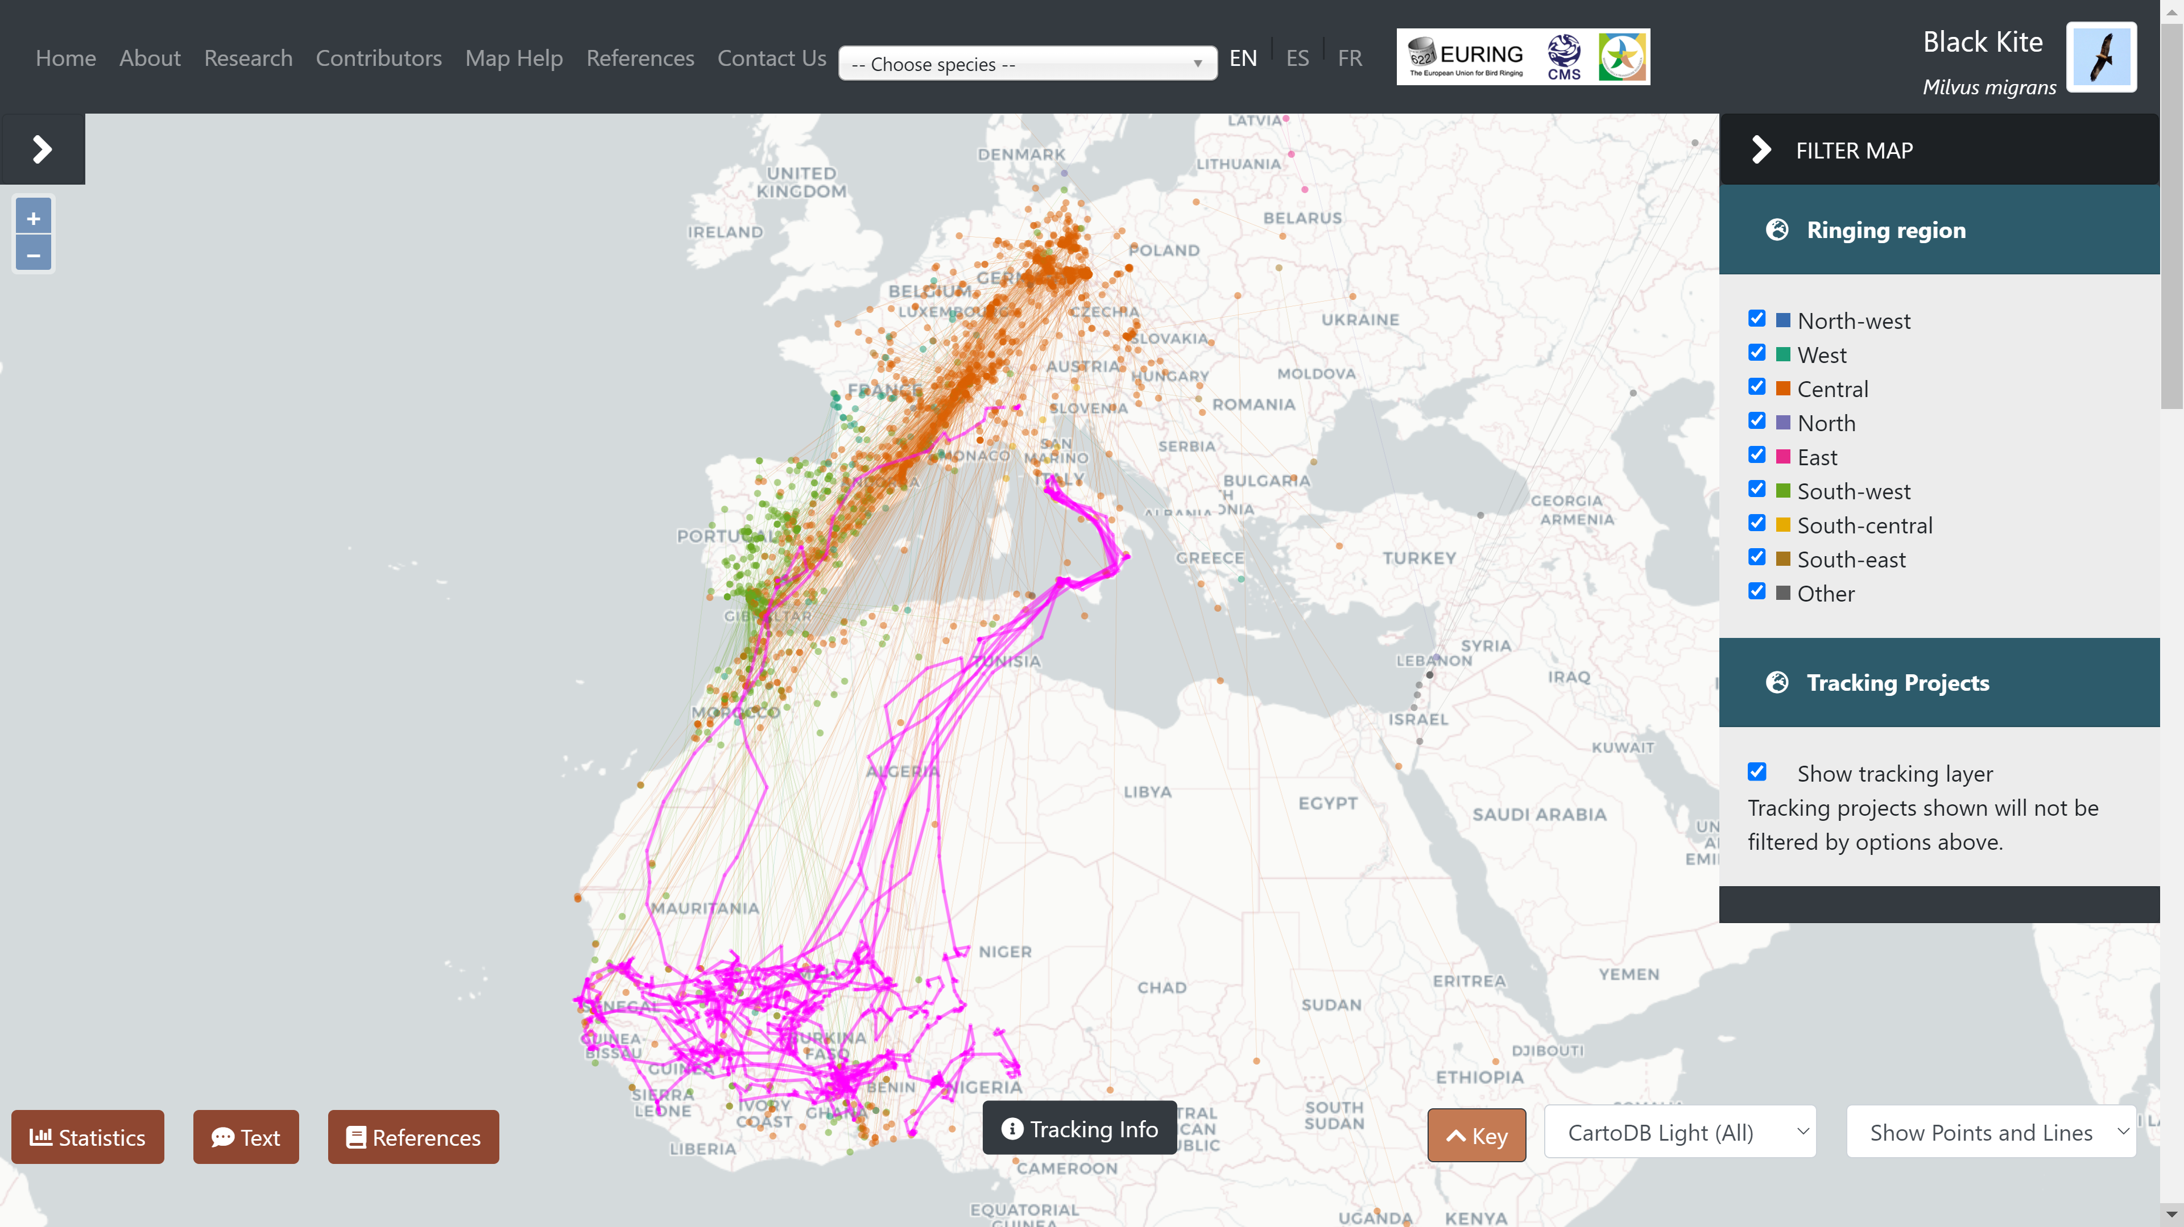
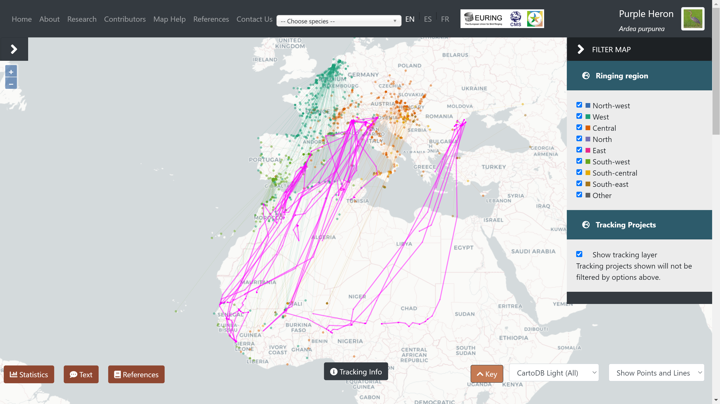
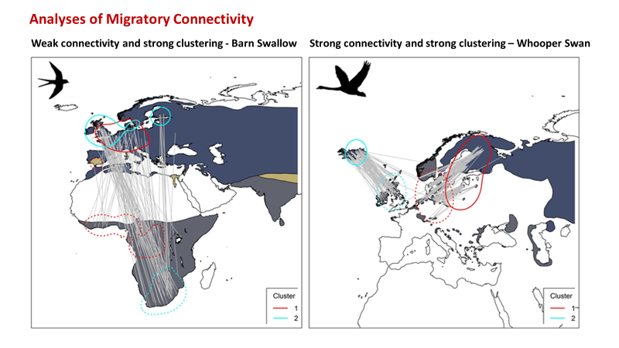
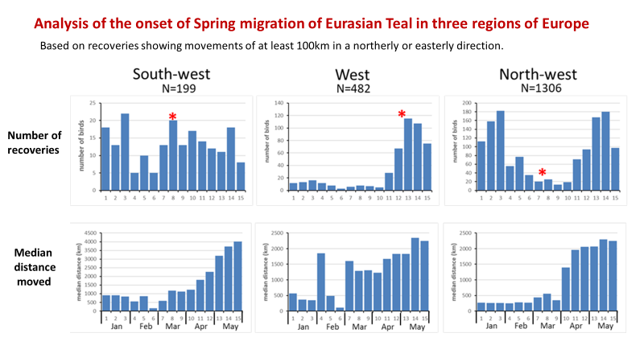
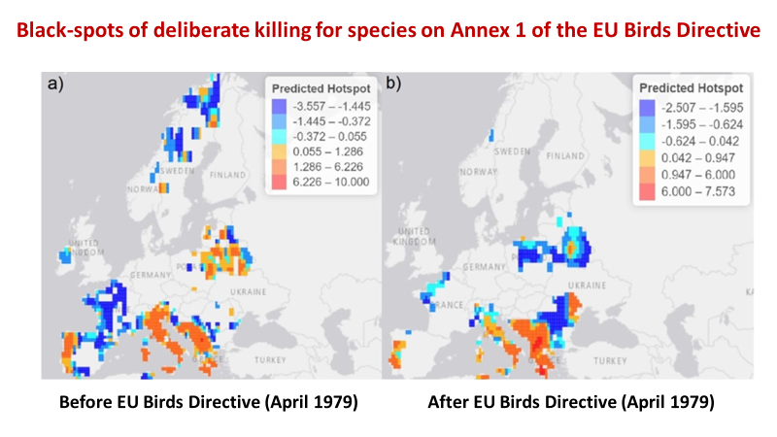
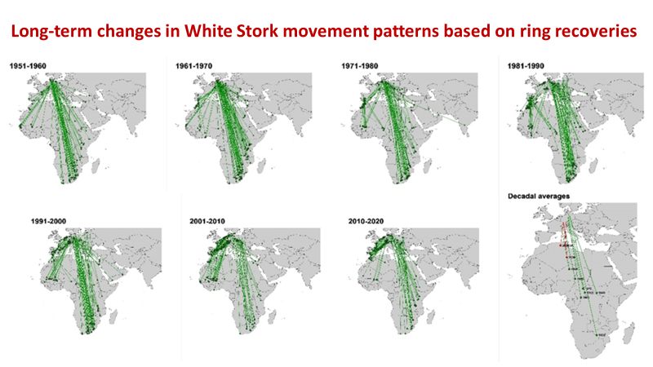
The
Eurasian African Bird Migration Atlas
https://migrationatlas.org
Spina, F.¹, Baillie, S.R.¹, Bairlein, F¹, Fiedler, W. and Thorup, K. (Eds) 2022. The Eurasian African Bird Migration Atlas. EURING/CMS. ¹ Joint lead editors.
We present interactive movement maps based on ring recovery data for 300 species, using data from the EURING databank. The maps are based on standard ringing regions as shown.
Three additional recovery map types show connectivity by condition, connectivity by month (as here) and an animated presentation of movements by 10 day periods.
Combining ringing and tracking data provides a more complete picture of movement patterns, particularly for species wintering in Africa where recovery probabilities are low.
Purple Herons show mainly parallel migration, so birds breeding in more easterly regions of Europe overwinter further east in Africa. Tracks of easterly populations improve coverage.
Migratory connectivity and clustering was quantified for 137 species with sufficient recovery data. Here we contrast the patterns for Barn Swallow and Whooper Swan.
Estimates of the onset of Spring migration are needed in relation to the definition of hunting seasons under the EU Birds Directive. We illustrate how ring recoveries can be used for this.
Reported causes of death from ring recoveries can be used to analyse geographical and temporal variation in deliberate killing. Patterns have improved but some problems remain.
Migration patterns of many species have changed over time in relation to climate and other environmental change. White Stork movements shown here provide a good example.

